Slide 1


Parallel Programing
Mid-term report
Reporter: HaochengLian

Slide 2

Parallel Programing
CONTENTS
1. Analysis
2. Strategy
Analysis matrix structure, and choose solution.
Replace “gemm” with “spmm”!
3. Details
4. Result
Some details to optimize better.
Show our work~

Slide 3


Matrix<-1
Complexity<-2
Parallel Programing
01
Analysis
Analysis matrix structure, and choose solution.

Slide 4
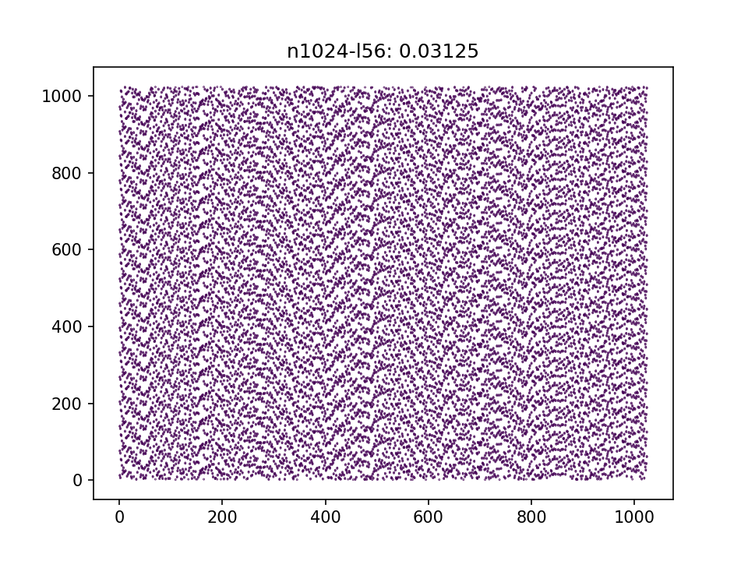
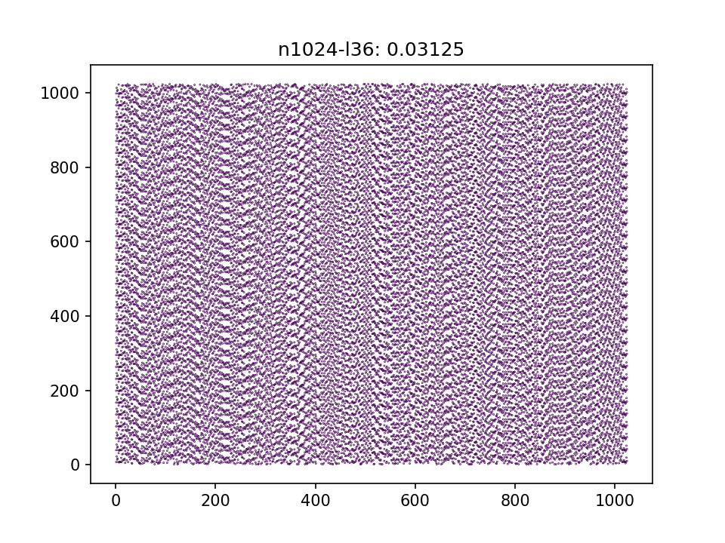
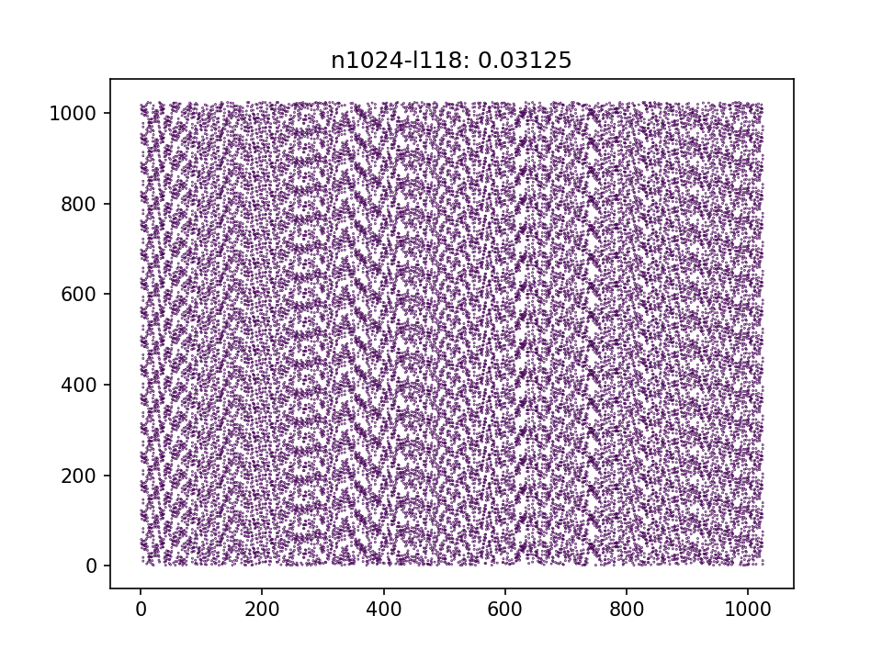
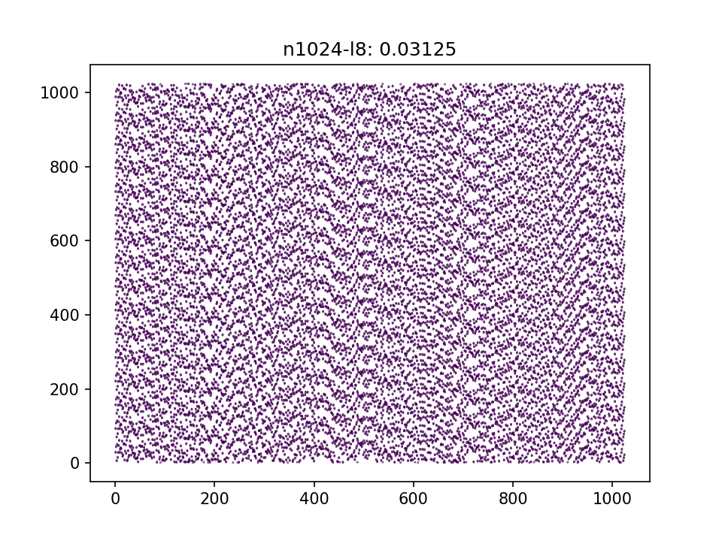
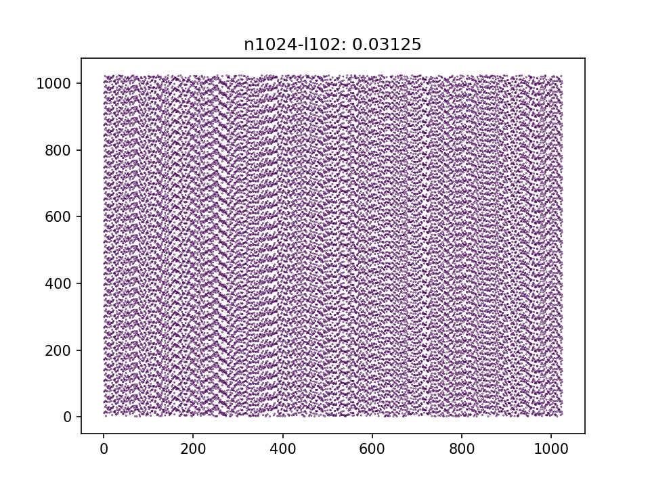
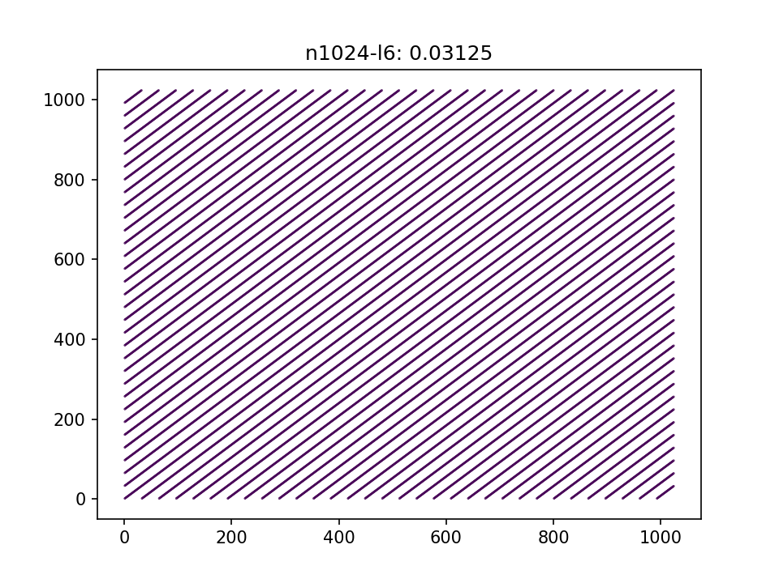
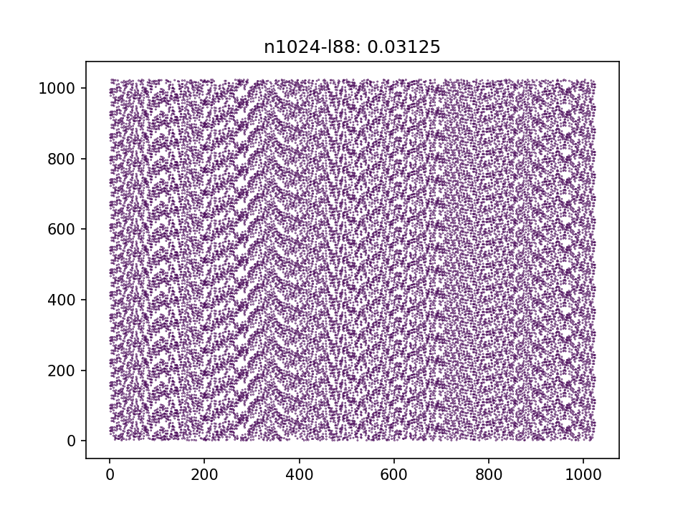
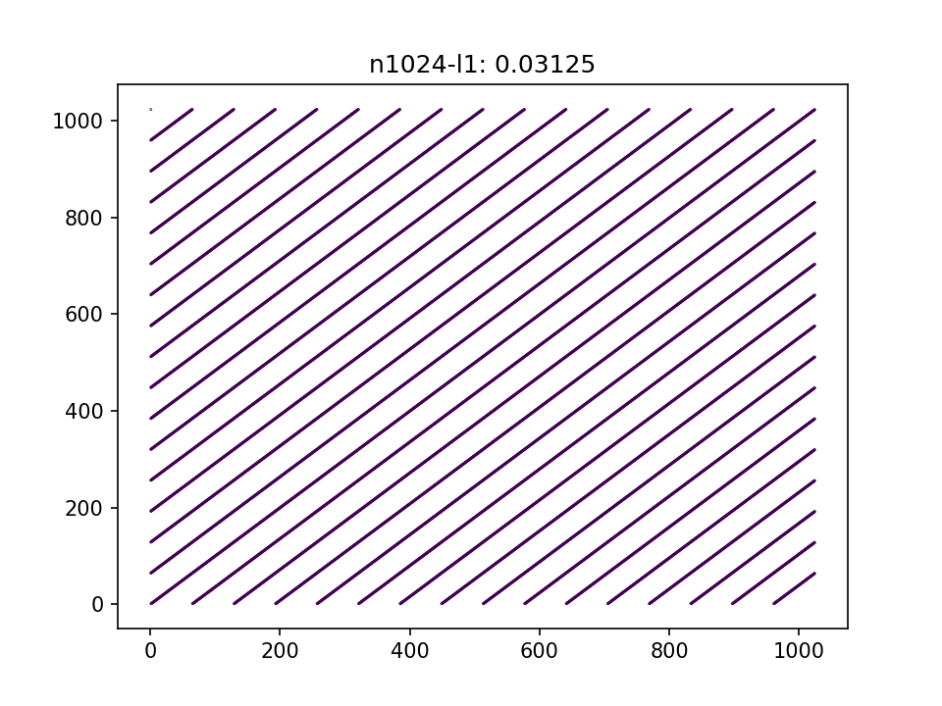
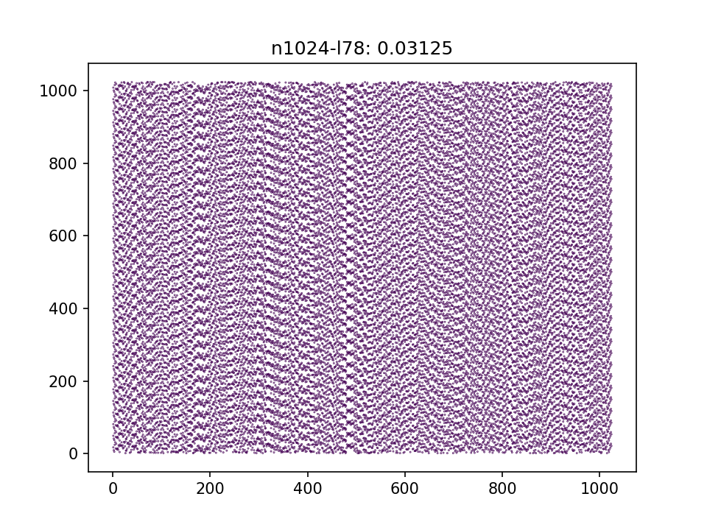
Matrix Struct
All are sparse.
All sparse matrices，
and the B’s sparsity is 0.03125.
The distribution of some B matrices
is very regular.
B matrices’ size are all the (1024, 1024)
A’s size (60000, 1024), with
sparsity ≈ 10%, but the result of A’s
sparsity is 4%

Slide 5
Complexity
GEMMM vs SPMM
Set Zero
Set Zero
O(mk)
O(mk)
GEMM
SPMM
O(mnk)
O(nnzA * nnzB / k)
BIAS + RELU
BIAS + RELU
O(mk)
O(mk)
Copy
Dence -> CSR
O(mk)
O(mk)

Slide 6

ZERO<-1
SPMM<-2
BIAS<-3
D2CSR<-4
Parallel Programing
02
Strategy
Our optimization for the left four steps.

Slide 7
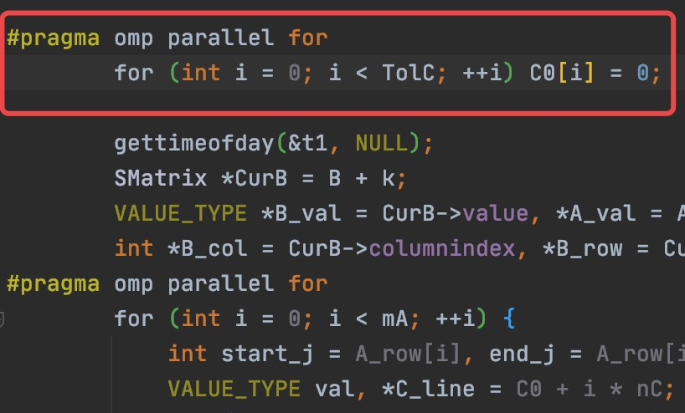
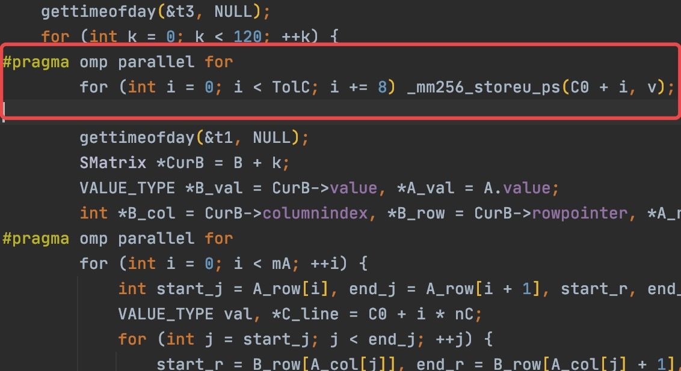
ZERO
Openmp vs openmp + avx
FOR-LOOP
Minimum using time: 1.2s
AVX VECTOR
Minimum using time: 0.82s

Slide 8
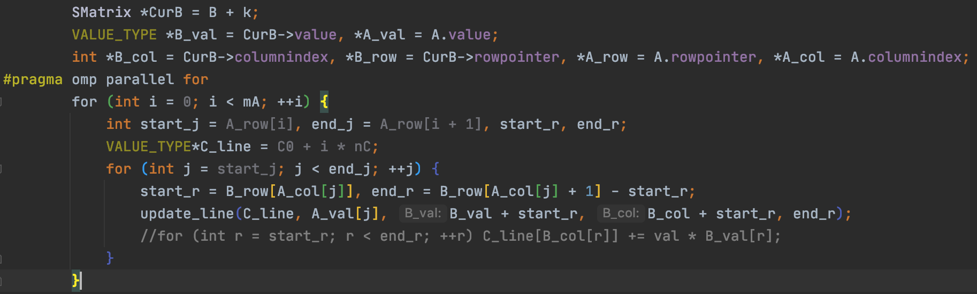
SPMM
CSR * CSR -> Dence
Notice that: “#pragma omp parallel for”, the reason why we not used “schedule(dynamic)”is that
the structure of B matrixes determines that almost every thread is load balanced. So we can cancel
“schedule(dynamic)”to reduce the extra overhead.
B矩阵的结构决定了CSR*CSR过程几乎全是线程均衡的，因此无需开启openmp的schedule(dynamic)以
减少时间开销

Slide 9
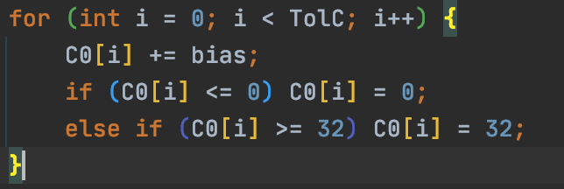
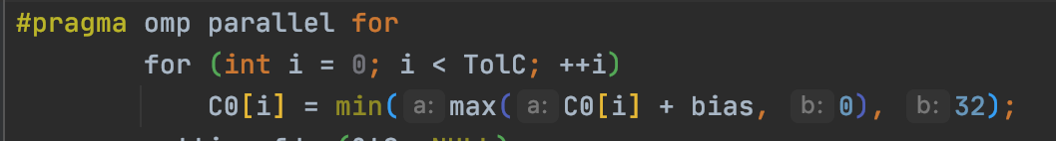
BIAS + RELU
Macro function
Raw BIAS+RELU
Macro function!

Slide 10
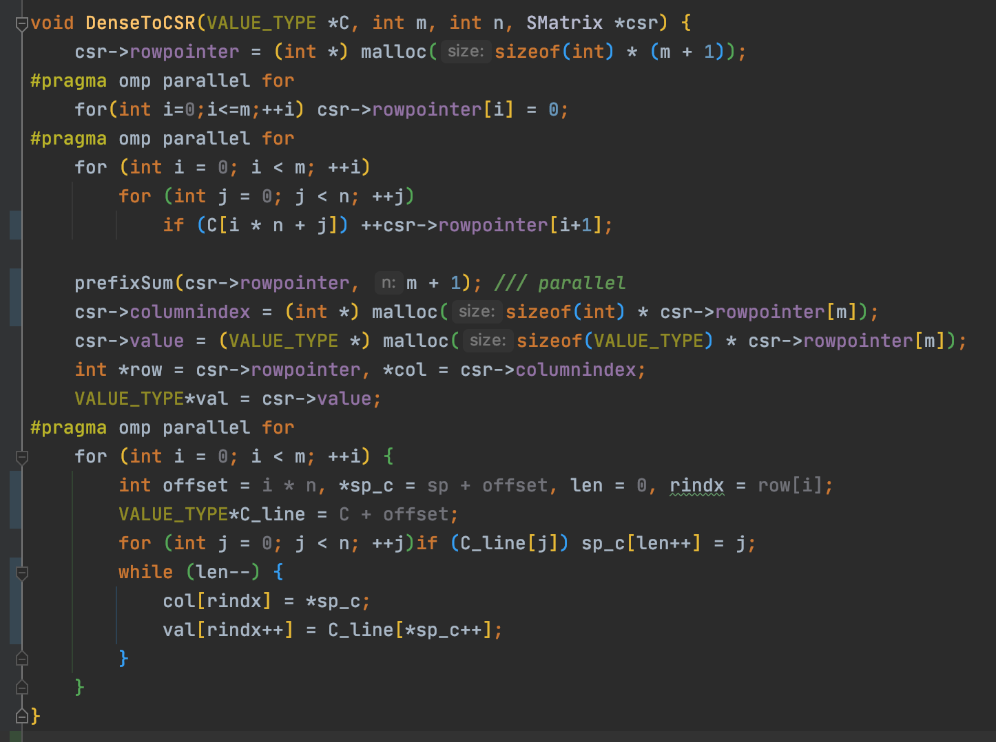
Dence 2 CSR
Parallel Algorithm
Count the number of elements per row
Parallel computing prefix summary
Fill in the column number and value in
parallel
All Done

Slide 11
Memory<-1
Compile<-2
Parallel Programing
03
Details
Other tips for optimization

Slide 12
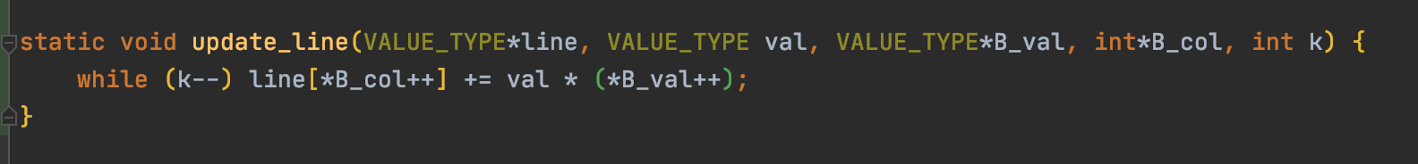
Memory access optimization
CSR * CSR -> Dence

Slide 13
Compile Optimization
Ofast!
gcc-9 –Ofast –fopenmp –lm main.c
–frename-registers –funroll-loops –mavx2
We Used!
We tried but failed, because of openmp or the version of gcc!
Compile and run to prepare profile to optimize:
gcc-9 –Ofast –fopenmp –lm main.c –fprofile-generate
Use the profile to help compile optimization:
gcc-9 –Ofast –fopenmp –lm main.c –fprofile-use

Slide 14
Parallel Programing
04
Result
Show out work

Slide 15
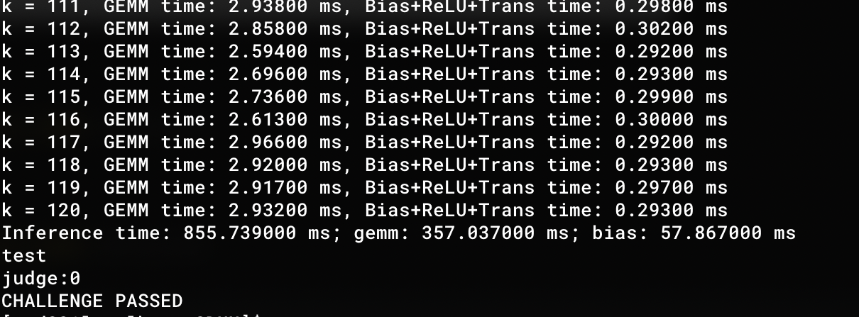
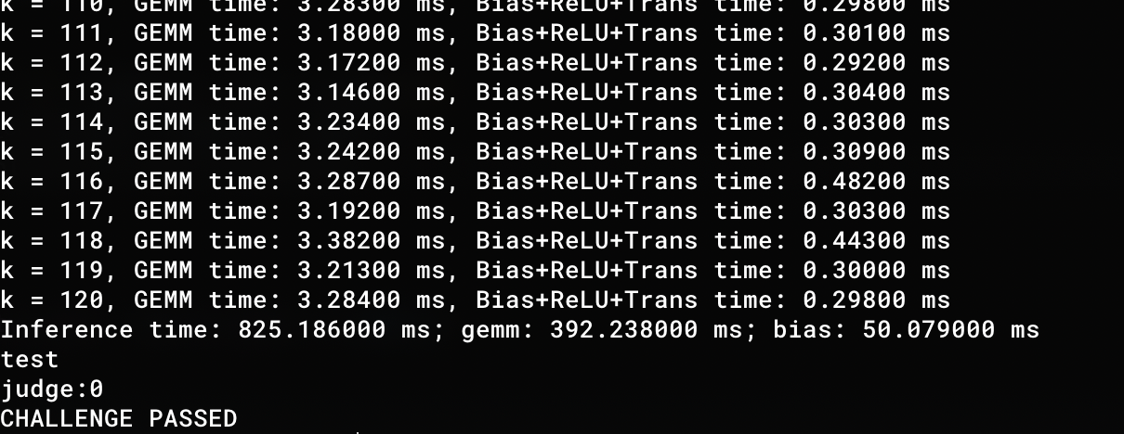
Result: 825.186ms

Slide 16
MID-TERM REPORT
2020.10.5
THANKS FOR YOU
感谢聆听
GROUP 2

